Slide 1
Python Project
International Development Association Statement of Credits and Grants
By Marc Arnaud Kambou

Slide 2
Objective and data description
Objective: Analysis on Public debt through credits and loans provided by IDA
Data description:
Rows : 8,770
Columns : 30
End of period : December 31st, 2019
Period range : May 12, 1961 to December 31st, 2019

Slide 3
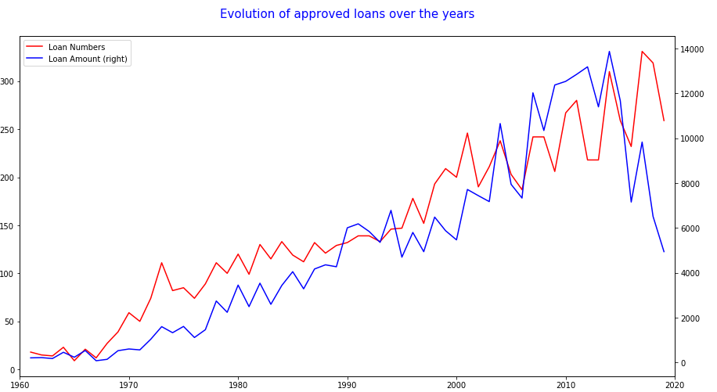
Loans approval over the Years
We observe that loans approval increased over the years
Around 2015-2016 we observe a drop in loan approvals and amount

Slide 4
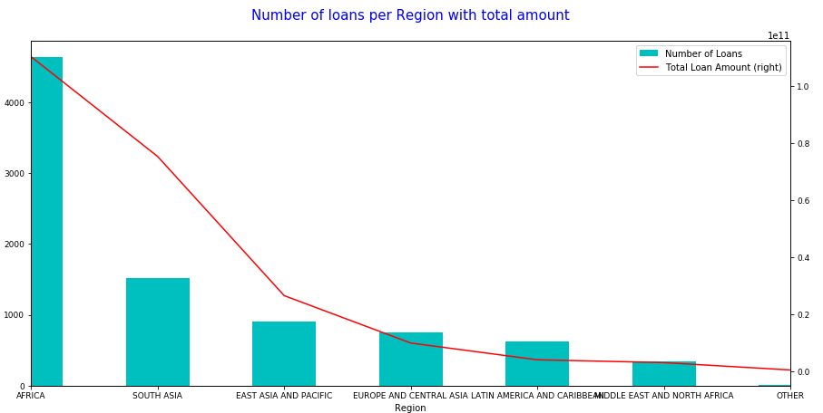
Loans Amount per region
Graph representing loans number and amount per region
We observe Africa has the most number of loans
South Asia as less loans but the amount is high

Slide 5
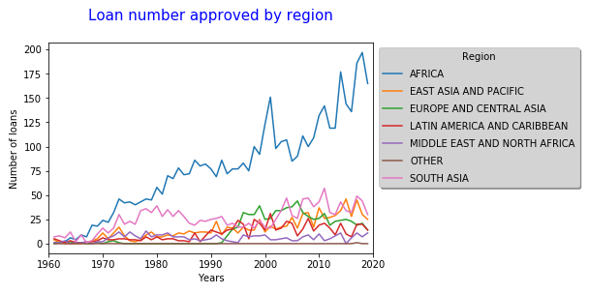
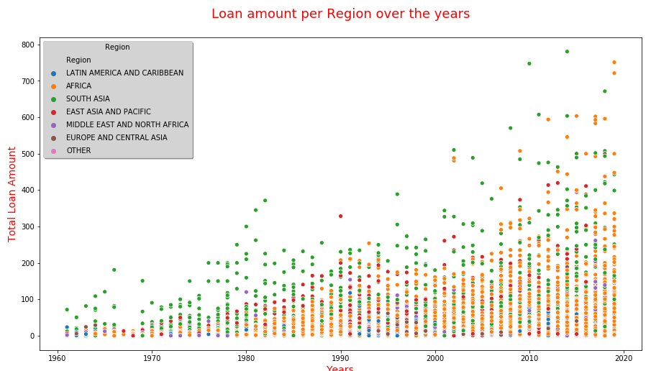

Slide 6
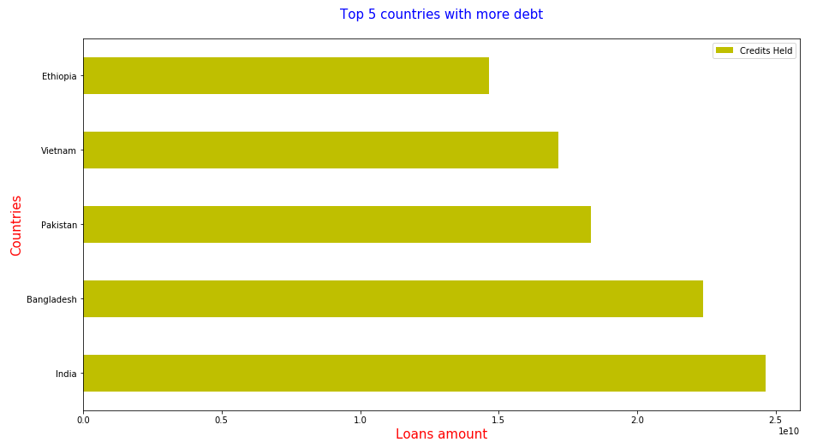
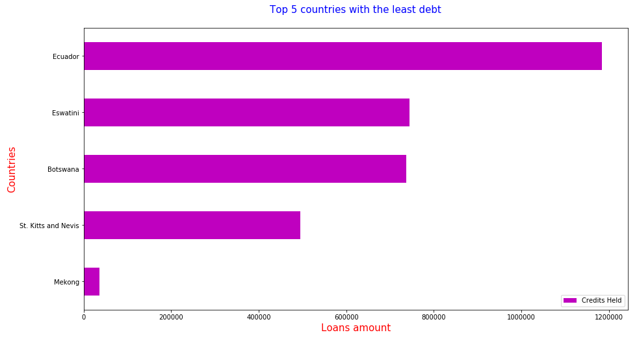
The top 5 countries with most debt and least debt

Slide 7
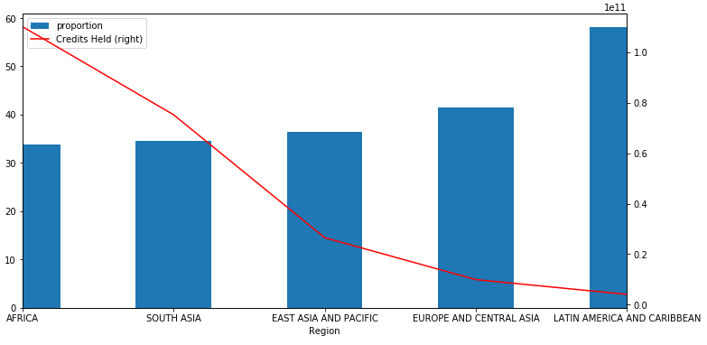
Ratio of repayment
Africa and South Asia are repaying the loans more slowly than they are receiving

Slide 8
Thank you

